Slide 1
CODE & CRUNCH
Arav Gupta
Rahul Thakur
Sanshray Mittu

Slide 2
Case Study Understanding
Wiretel Telecom is facing high customer churn, impacting revenue and market positioning.
Churn rate: 18.4% (above industry average of 12%)
Customer data accuracy: Only 23%, making churn prediction unreliable
Revenue loss per 1% churn increase: ₹8 Cr
Silent churners: 80% of churned customers never complain
Major causes: Poor service quality, lack of impactful marketing, and ineffective loyalty programs

Slide 3
Problem Statement
Why is Wiretel experiencing higher churn despite customer service improvements?
Key Challenges:
Network issues remain unresolved (No major infrastructure improvements)
Loyalty programs don’t engage new customers
Advertisements fail to connect with Indian sentiments
High data inaccuracy weakens churn prediction models

Slide 4
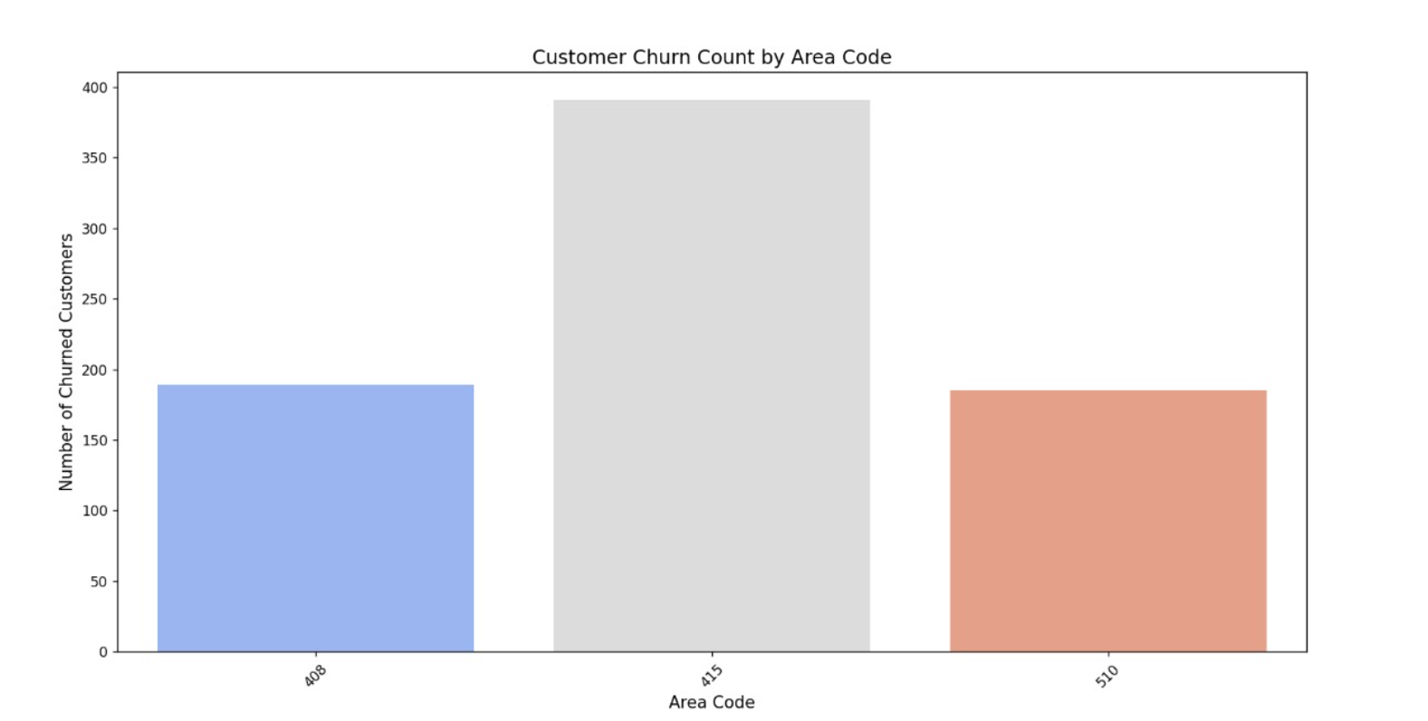
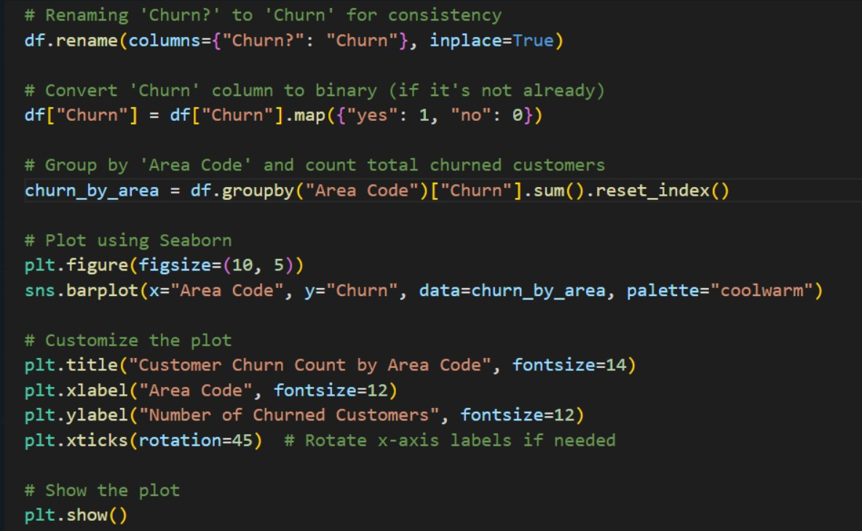
Approach to Address the Problem
Assumptions Made:
Churn rate can be reduced by 14.5% with strategic interventions
Retailers & AI-driven behavioral analytics will improve data accuracy from 23% to 55%
Network investments must be prioritized for long-term retention impact
Root Cause Analysis (RCA) Framework Used:
Customer Cohort Analysis → Identified churn patterns across different user segments
Predictive Analytics with AI → Churn likelihood prediction using real-time behavioral triggers
Market Sentiment Analysis → Identified gaps in advertisement effectiveness
Do Mention : Assumptions made
Area Inferencing

Slide 5
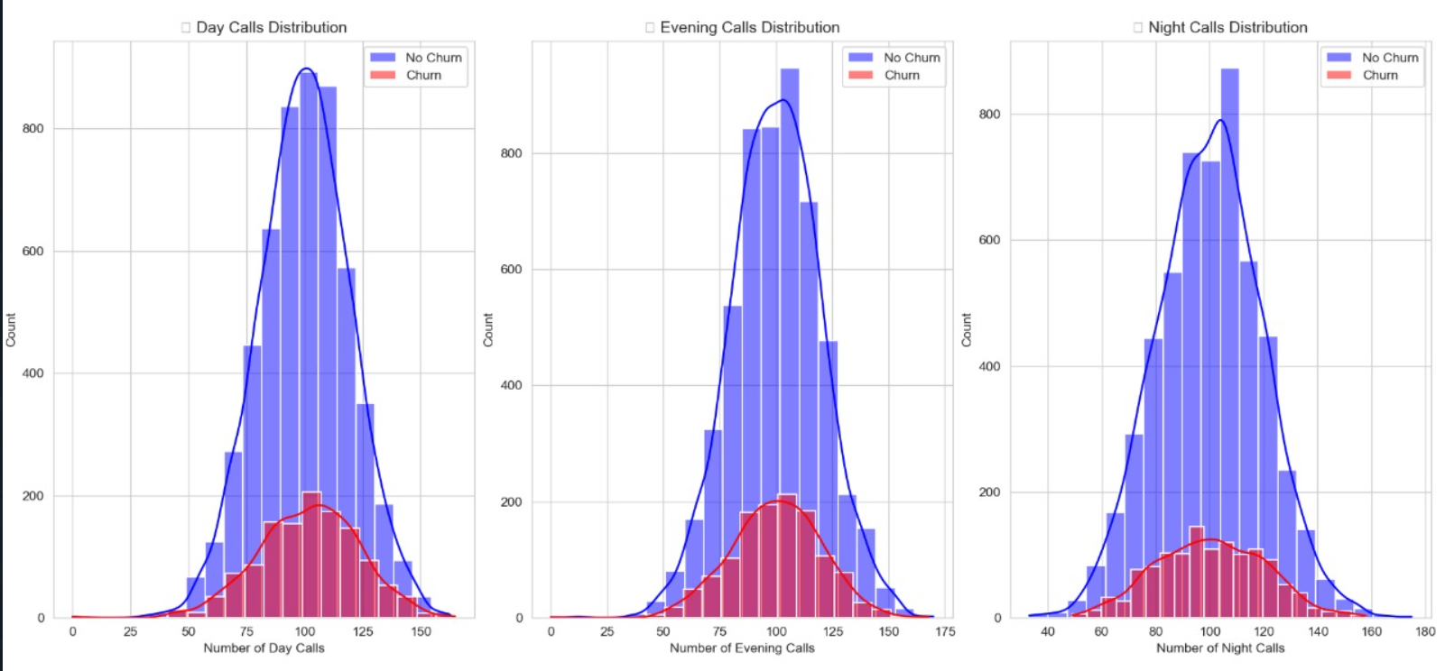
Solution Recommendation
A. Data-Driven Customer Retention Strategy
✅ Fix data accuracy issue:
Use AI to analyze real-time engagement data (e.g., data usage drop, call drop frequency).
Retailer data integration: Incentivize retailers to provide updated KYC data → Improve accuracy from 23% to 55%.
✅ Target Silent Churners Proactively:
Trigger re-engagement offers when usage patterns decline (e.g., no data usage for 5 days = SMS offer).
✅ Churn Prevention Impact:
Projected churn drop: 18.4% → 11.5%
Revenue retention impact: ₹8 Cr saved per 1% churn drop = ₹54.4 Cr net savings
1. Maximum Churning in the day and evening Many users making frequent calls during the day could be professionals or businesses. If they experience poor service (e.g., dropped calls, bad network quality, or high costs), they may switch providers.2. night users might be more casual callers who are less affected by service quality issues.

Slide 6
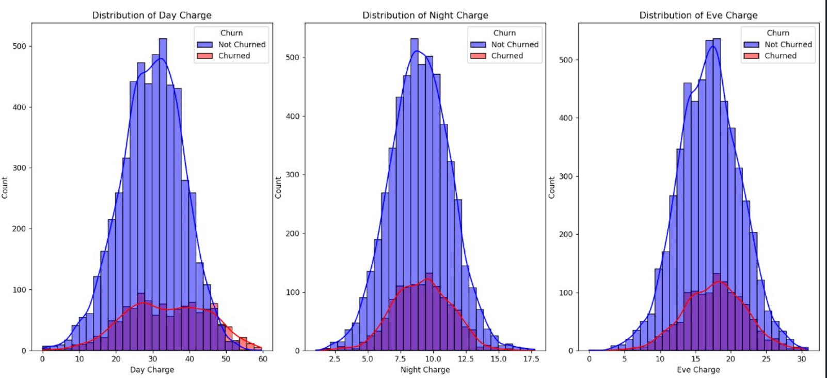
Solution Recommendation
B. Infrastructure Investments for Long-Term Churn Reduction
✅ Identify high-churn zones (geo-mapping churn hotspots) and prioritize network upgrades there.
✅ Deploy 4G network enhancements → Reduce dropped calls from 2.1% to <1.2%.
✅ Expected churn impact: 11.5% → 9.8% (long-term impact)
C. Marketing & Loyalty Program Reforms
✅ New Customer Loyalty Initiatives:
Engage new customers in the first 90 days with instant loyalty perks → Expected 3% churn drop in the new customer segment.
✅ Culturally Relevant Advertising:
Regional & sentiment-based campaigns → Higher emotional connect = 12% increase in ad engagement.
maximum peak or recharging is done in night or evening that means in the later half of the day we perform better

Slide 7
Parking Lot
Parking Lot (Unresolved or Future Considerations)
🔹 Need to explore alternative data enrichment methods (e.g., social media activity tracking). 🔹 Financial feasibility of long-term infrastructure upgrades. 🔹 Effectiveness of AI-based churn prevention in the Indian market (A/B testing needed).

Slide 8
CODE & CRUNCH
Thank you.

